Slide 1
FAY OL’S
GENERAL ADMINISTRATIVE
THEORY

Slide 2
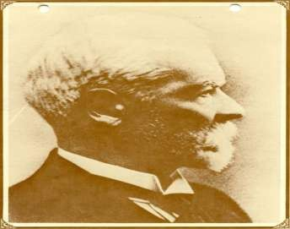
HENRI FAYOL (1841-1925)
▪ Fourteen Principles of as one of the classical organization theory
that is PRINCIPLES OF MANAGEMENT were developed by
Henri Fayol and have been considered universally
applicable to every type of organization.

Slide 3
THEORY
◻ Fayolism
Fayol's work
was one of the first
comprehensive statements of a general
theory of management. He proposed that there were six primary functions of management and 14 principles of management.

Slide 4
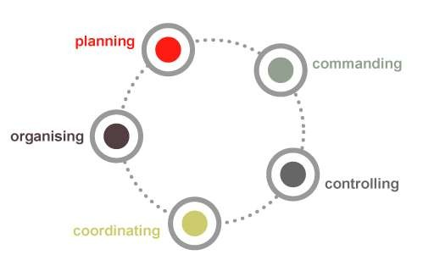
sting
ing
mmanding
dinating
Functions
1.
Foreca
1.
Planning
2.
Organiz
3.
Co
4.
Coor
5.
controlling
Functions of management

Slide 5
▪
▪
▪
▪
▪
▪
▪
▪
▪
▪
▪
▪
▪
▪
DIVISION OF WORK OR SPECIALIZATION
AUTHORITY AND RESPONSIBILITY
DISCIPLINE
UNITY OF COMMAND
UNITY OF DIRECTION
SUBORDINATION OF INDIVIDUAL TO GENERAL
REMUNERATION
CENTRALIZATION
LINE OF COMMAND/SCALAR CHAIN
ORDER
EQUITY
STABILITY OF TENURE
INITIATIVE ESPRIT DE CORPS

Slide 6
DIVISION OF WORK OR SPECIALIZATION
Division of work makes a man specialist. The reason is
that division of work helps to specialize in an activity which
increases the output with perfection. It also avoids wastage
of time. Division can be applied to both technical and
managerial kind of work.

Slide 7
◻ Authority & Responsibility.
◻ Managers must be able to give orders.
Authority gives them this right. Note that responsibility arises wherever authority is exercised.

Slide 8
◻ Discipline.
◻ Employees must obey and respect the rules that
govern the organisation.

Slide 9
◻ Unity of command.
◻ Every employee should receive orders from only
one superior.

Slide 10
◻ Unity of direction.
◻ Each group of
organisational activities that have the same objective should be directed by one manager using one plan.

Slide 11
Subordination
of
individual
◻
The individual
should subordinate
self-interest to the
general good. It is
incumbent upon
management to
reduce conflict
between the
individual and the
general well being
wherever possible.

Slide 12
◻ Remuneration.
◻ Workers must be
paid a fair wage for their services.

Slide 13
◻ CENTRALIZATION
◻ Fayol thought
centralization of authority
to be desirable, at least for
overall control. Certainly,
both formulation of policy
and the generation of
basic rules and procedures
ought to be centralized

Slide 14
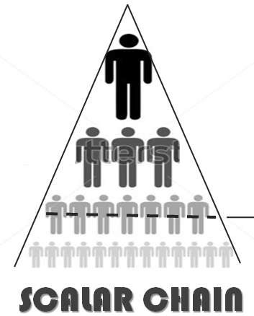
◻ Scalar chain.
◻ The line of authority
from top management the lowest ranks represents the scalar
to
chain. Communications
should follow this chain.

Slide 15
◻Order.
◻ People and materials
should be in the right place at the right time.

Slide 16
◻Equity.
◻ Managers should be
kind and fair to their subordinates.

Slide 17
◻ Stability of tenure of personnel.
◻ High employee turnover is inefficient. Management
should provide orderly personnel planning and ensure that replacements are available to fill vacancies.

Slide 18
Initiative.
◻
◻
The power of
thinking out, proposing and executing.
Management should encourage employees to
originate and
carry out plans.

Slide 19
◻ Esprit de corps.
◻
This means union is
strength or Team Spirit. He felt that all successful organizations survive only when a feeling of unity pervades the group and that viable organizations cleat with crises as a team.

